Slide 1

MARKETING CAMPAIGN OF OUR GAME
KOTTESWARAN S 221701031
LINGESH VK 221701032

Slide 2
CONTENTS
ABSTRACT
INTRODUCTION
OBJECTIVE
LITERATURE SURVEY
METHODOLOGY

Slide 3
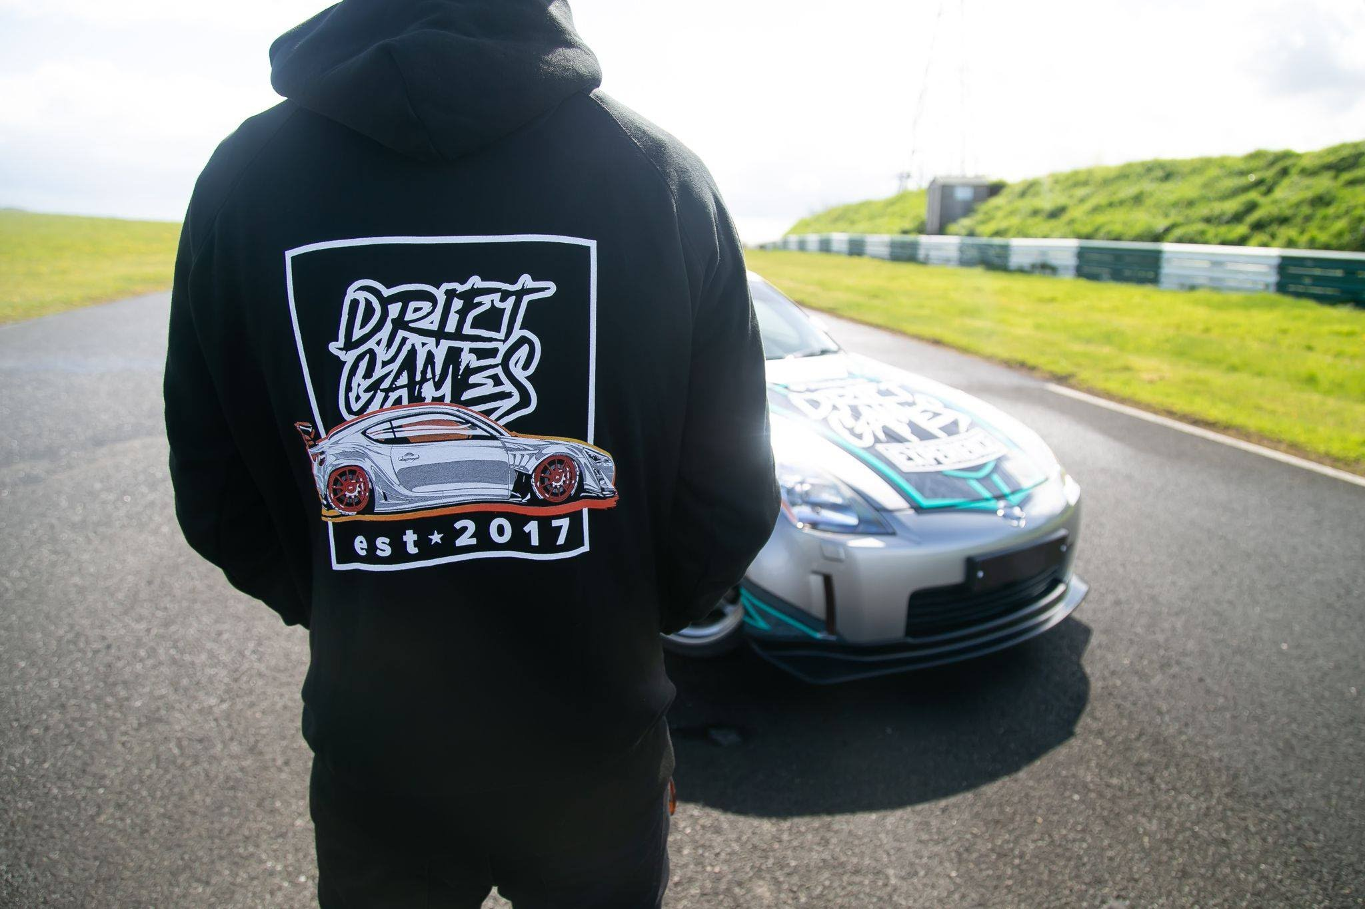
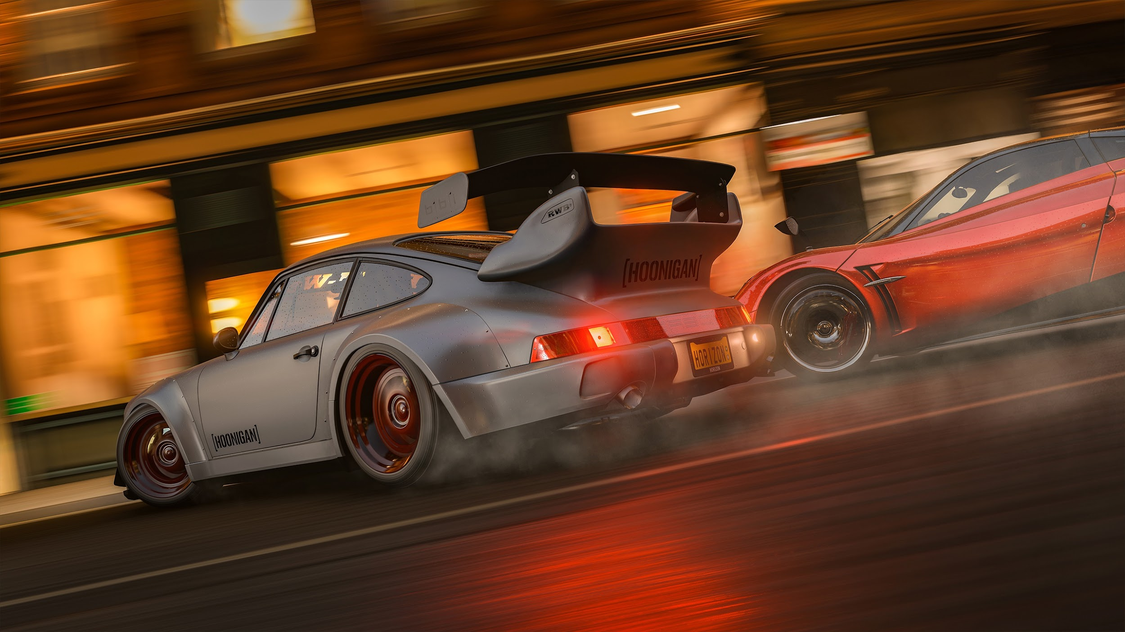
ABSTRACT
Abstract
Overview of the marketing strategy for the game.
Creating a strong brand presence through posters, trailers, merchandise, and digital promotions.
Goal: Attract gamers by showcasing cross-play, realistic drifting, and customization through engaging visuals.

Slide 4

INTRODUCTION
What is the Game About?
A Japanese-themed car drifting and racing game with immersive gameplay.
Why is Marketing Important?
Creates hype, builds a player community, and establishes brand recognition.
Marketing Channels:
Visual Marketing: Posters, digital ads, social media promotions.
Video Content: High-impact game trailer, teaser clips.
Merchandise: T-shirts, stickers, keychains to engage fans.

Slide 5
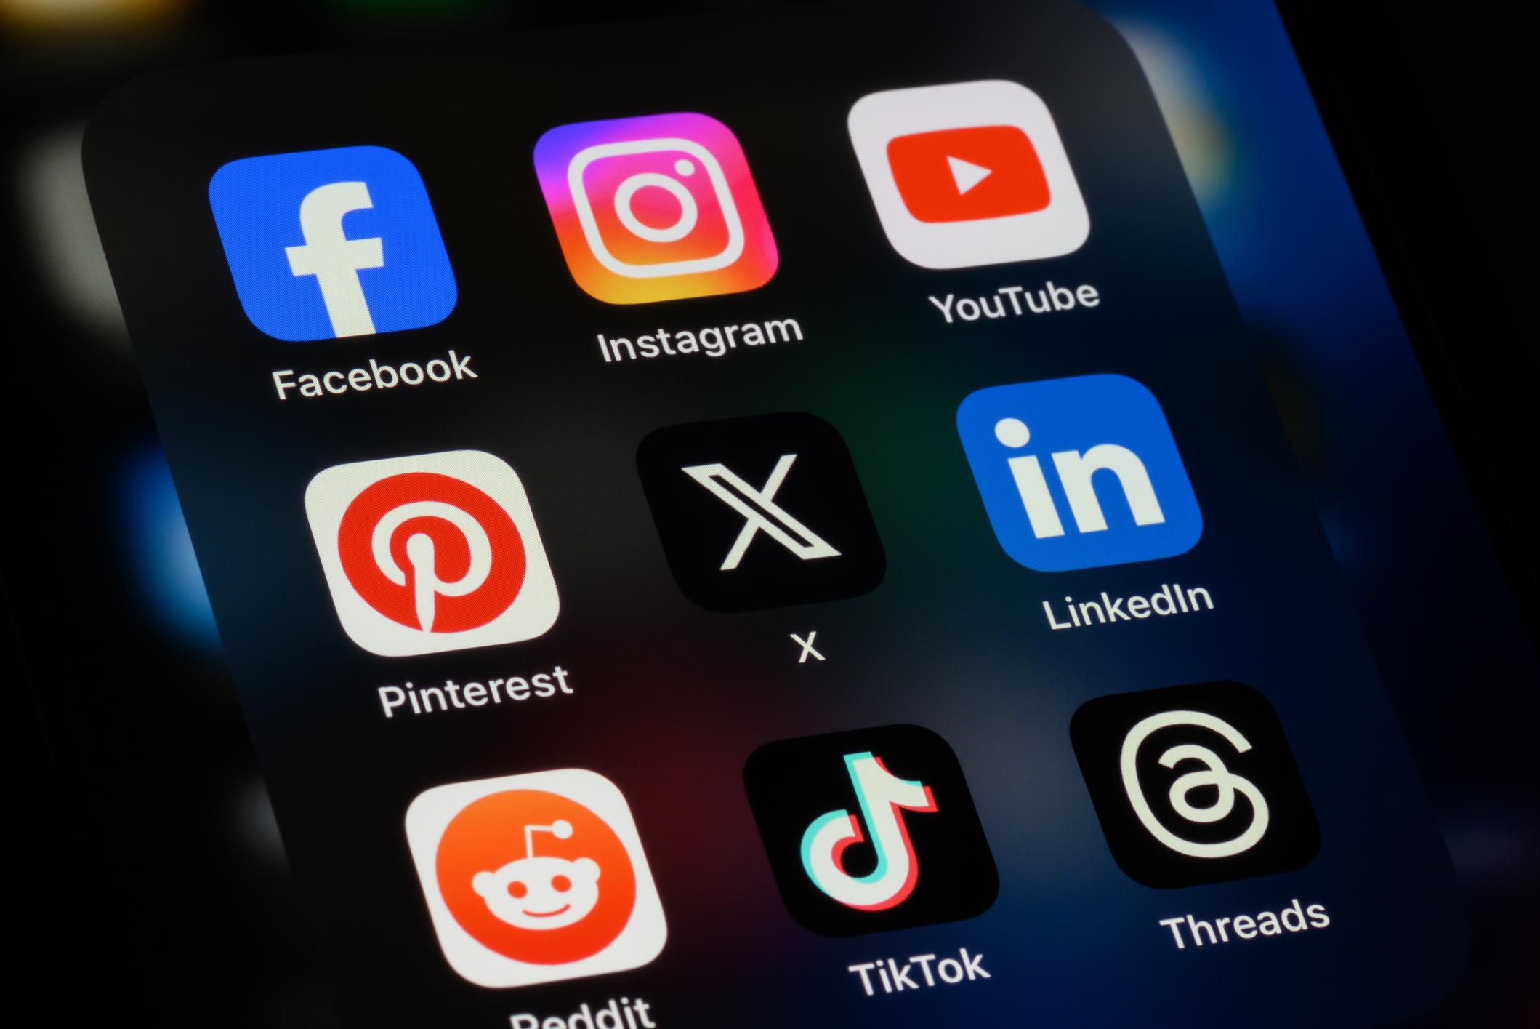
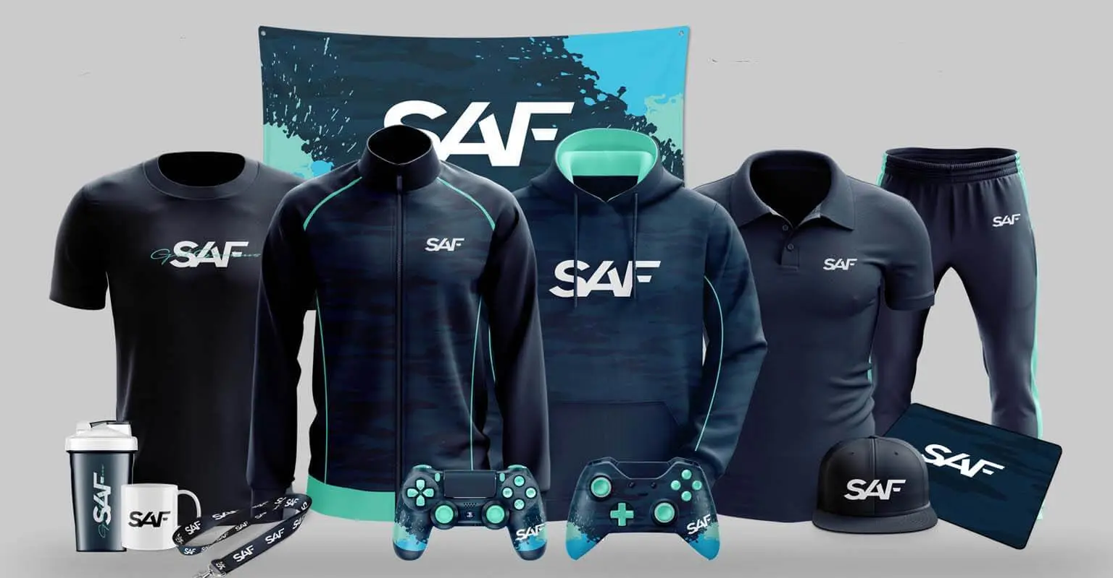
OBJECTIVE
Brand Awareness: Create a strong visual identity through high-quality posters and digital content.
Community Engagement: Use trailers, social media promotions, and giveaways to interact with players.
Pre-launch Hype: Teasers, influencer collaborations, and merchandise drops to generate buzz before release.
Maximizing Reach: Utilize cross-platform marketing (YouTube, Instagram, Twitch, TikTok, gaming forums).

Slide 6
LITERATURE SURVEY
Competitor Marketing Strategies:
CarX Drift Racing: Focused on gameplay clips but lacked extensive promotional campaigns.
Need for Speed: Strong trailers but limited community-driven engagement.
Few racing games leverage full cross-platform marketing efforts.
Limited mobile game branding—our approach will emphasize mobile-friendly promotion.
More interactive community involvement through merchandise and fan-generated content.

Slide 7
METHODOLOGY
Game Trailer Production: Capturing high-speed drifting action, dynamic camera angles, and cinematic effects.
Showcasing game features: cross-play, customization, and realistic physics.
Poster & Merchandise Design: Bold visuals featuring Japanese street racing culture, neon aesthetics, and stylish typography.Creating collectible merch (T-shirts, hoodies, stickers) with iconic in-game elements.
Social Media & Influencer Outreach: Collaboration with gaming influencers for early access gameplay and reviews.Running contests, giveaways, and interactive polls to engage the audience.
Launch & Post-Launch Strategy: Pre-launch hype through teasers and countdown campaigns.Ongoing marketing with updates, DLC promotions, and community events.

Slide 8
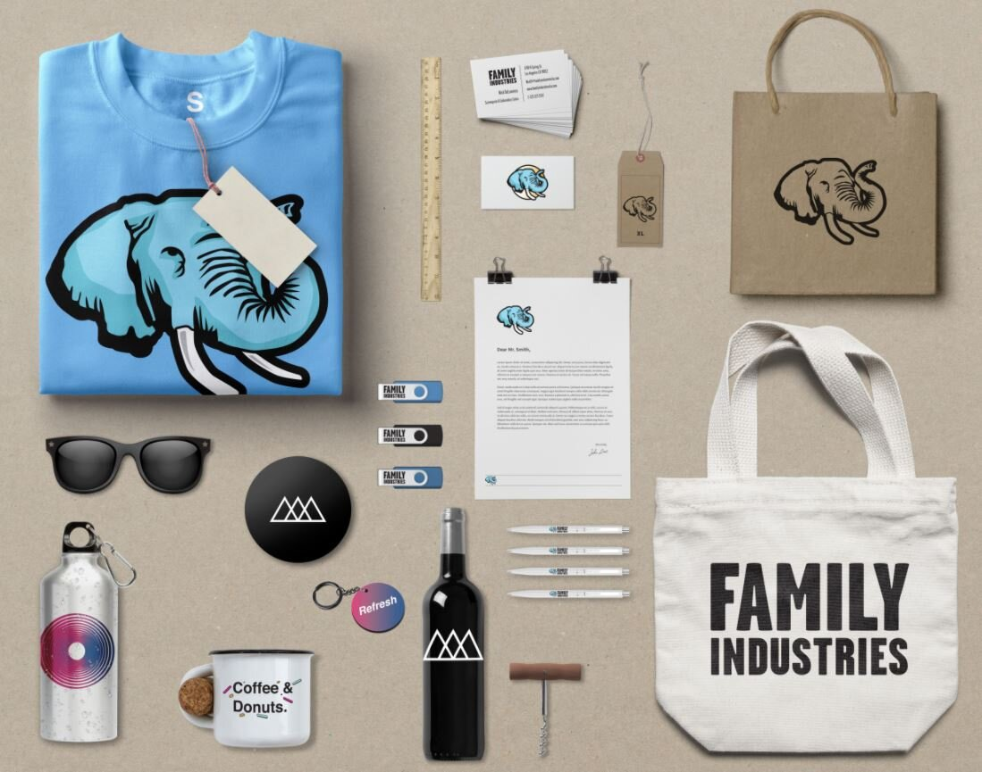
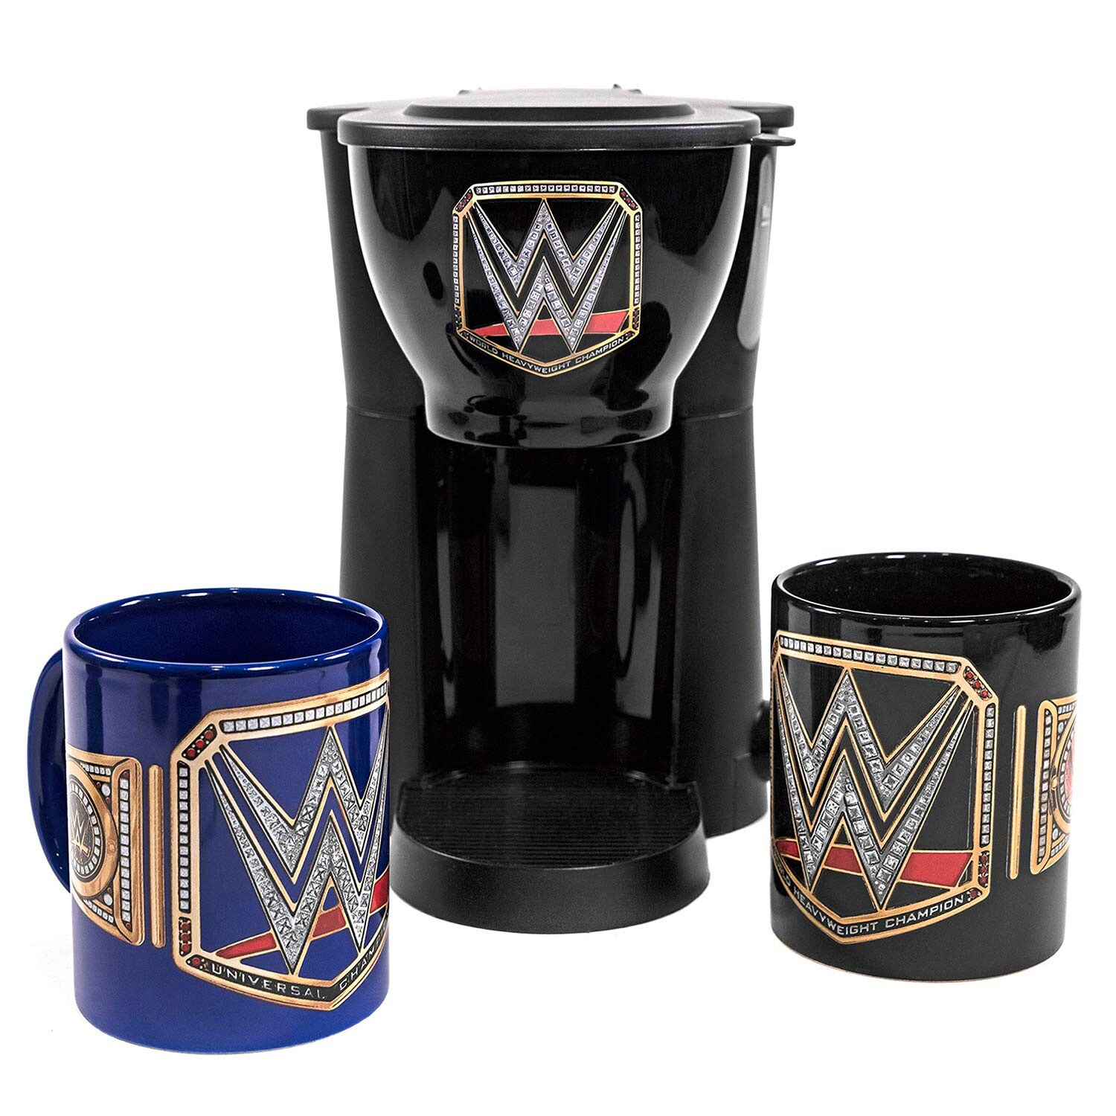
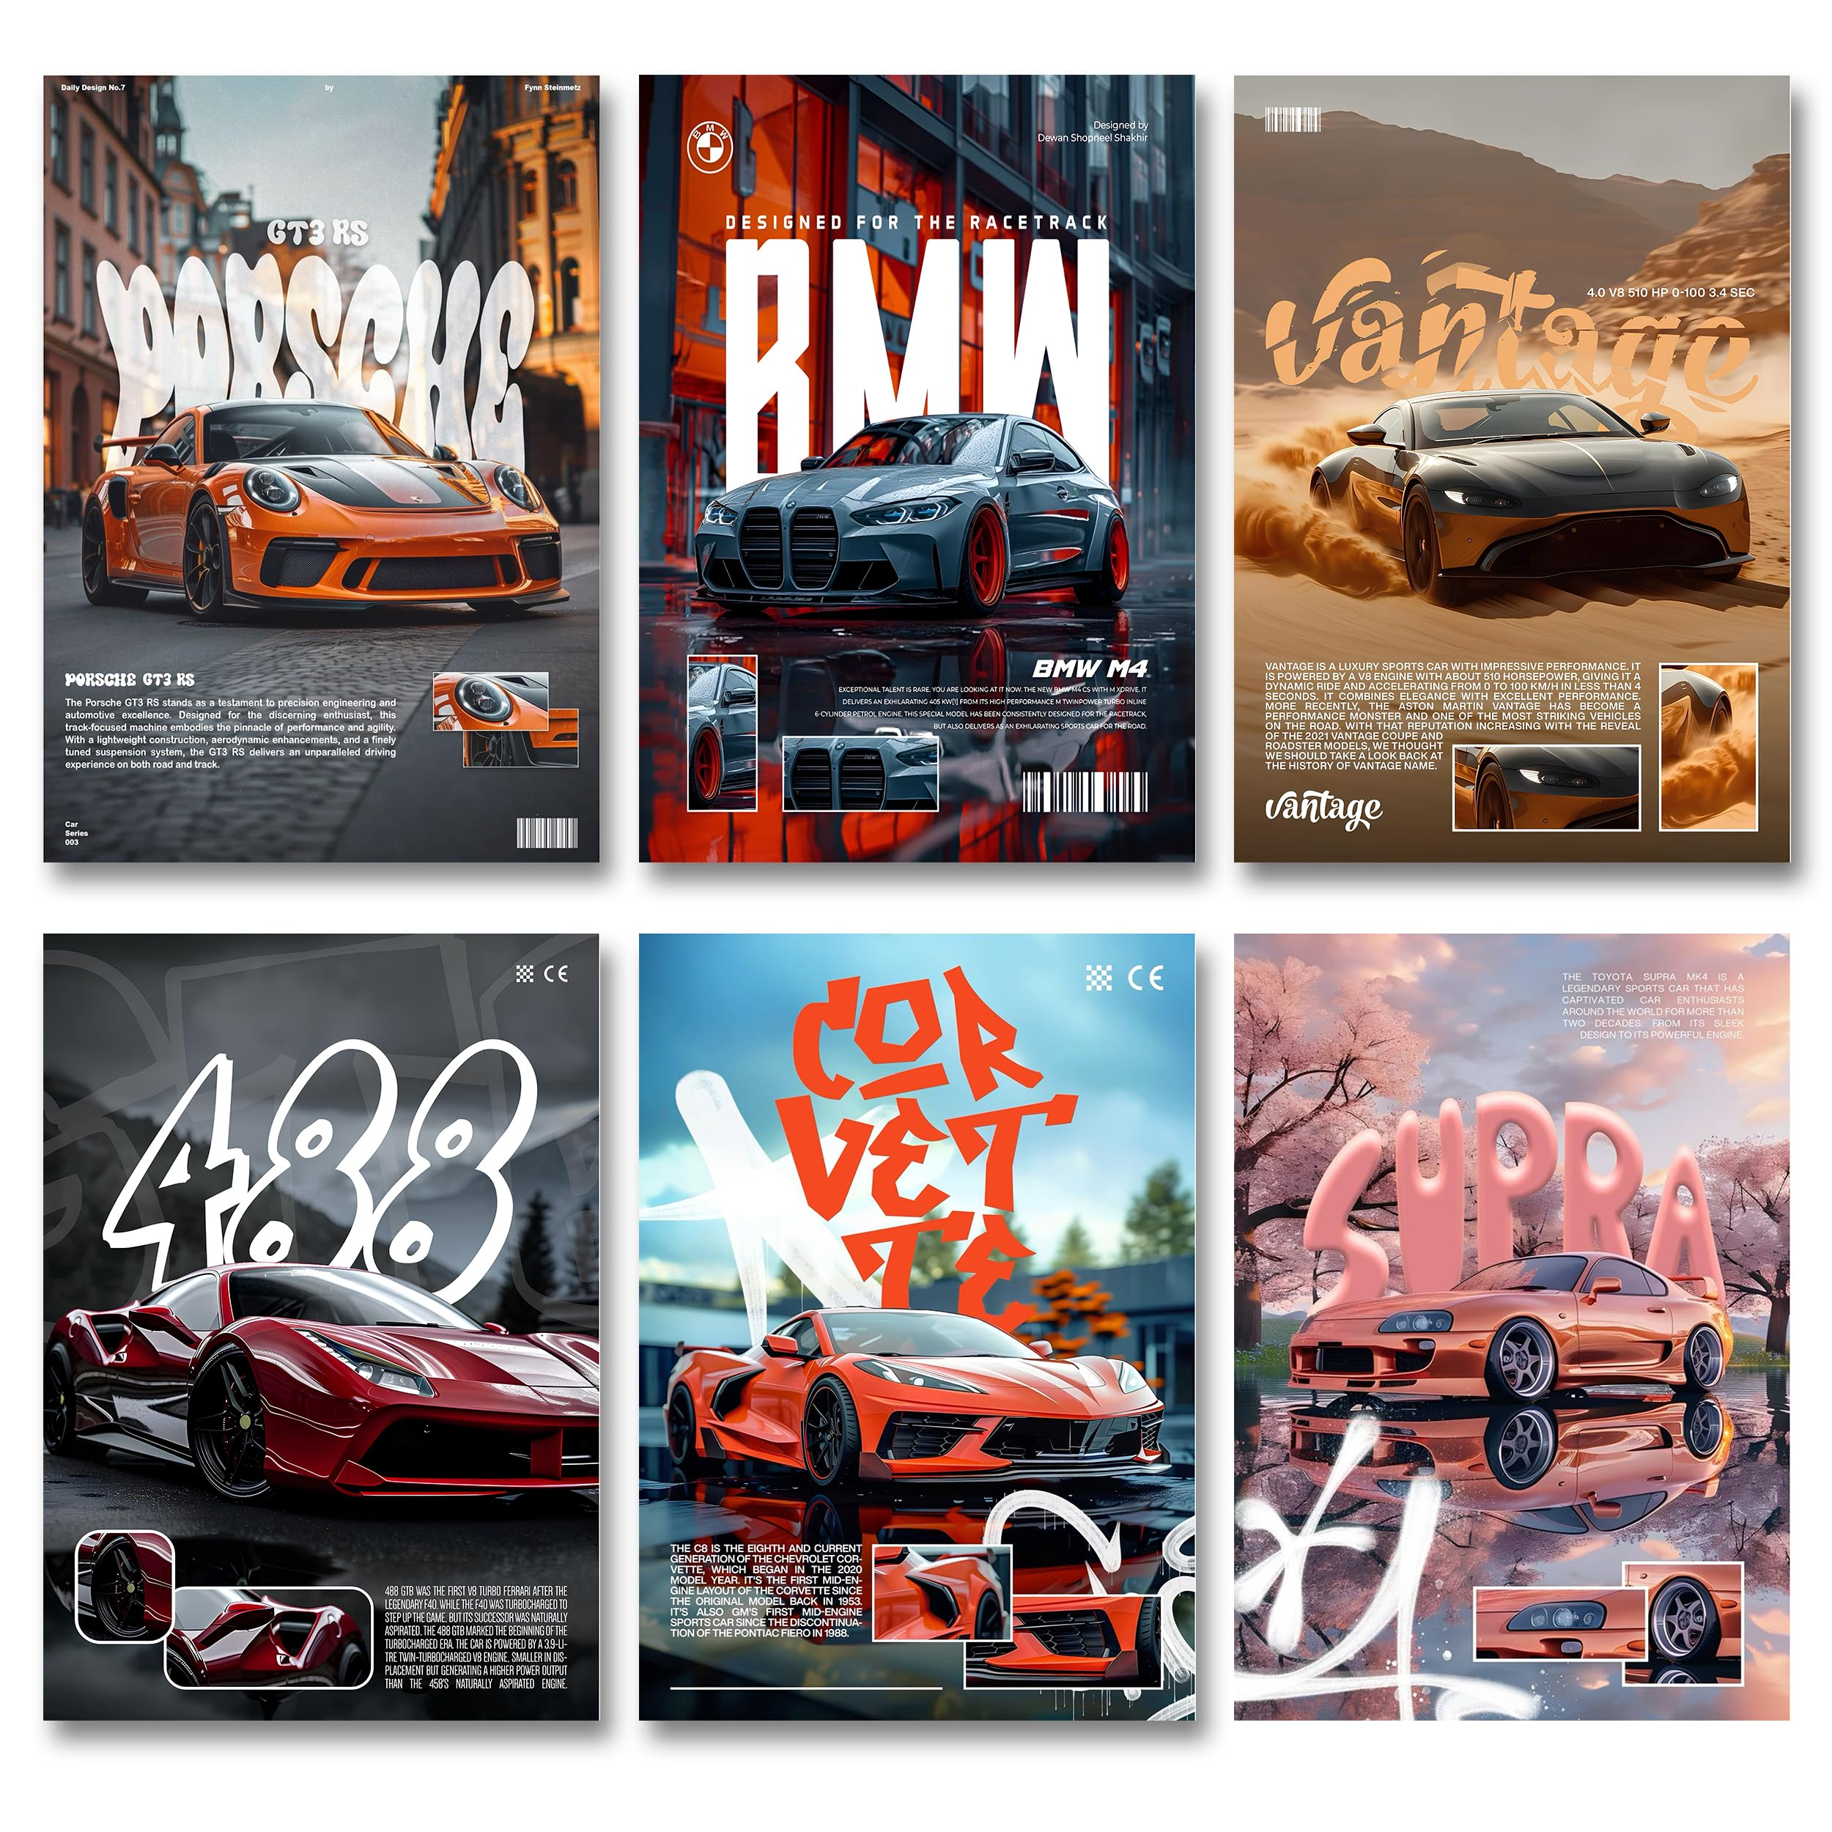
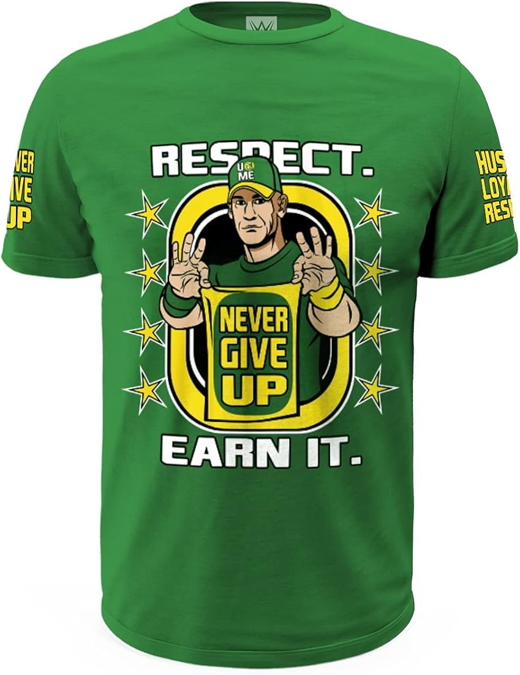
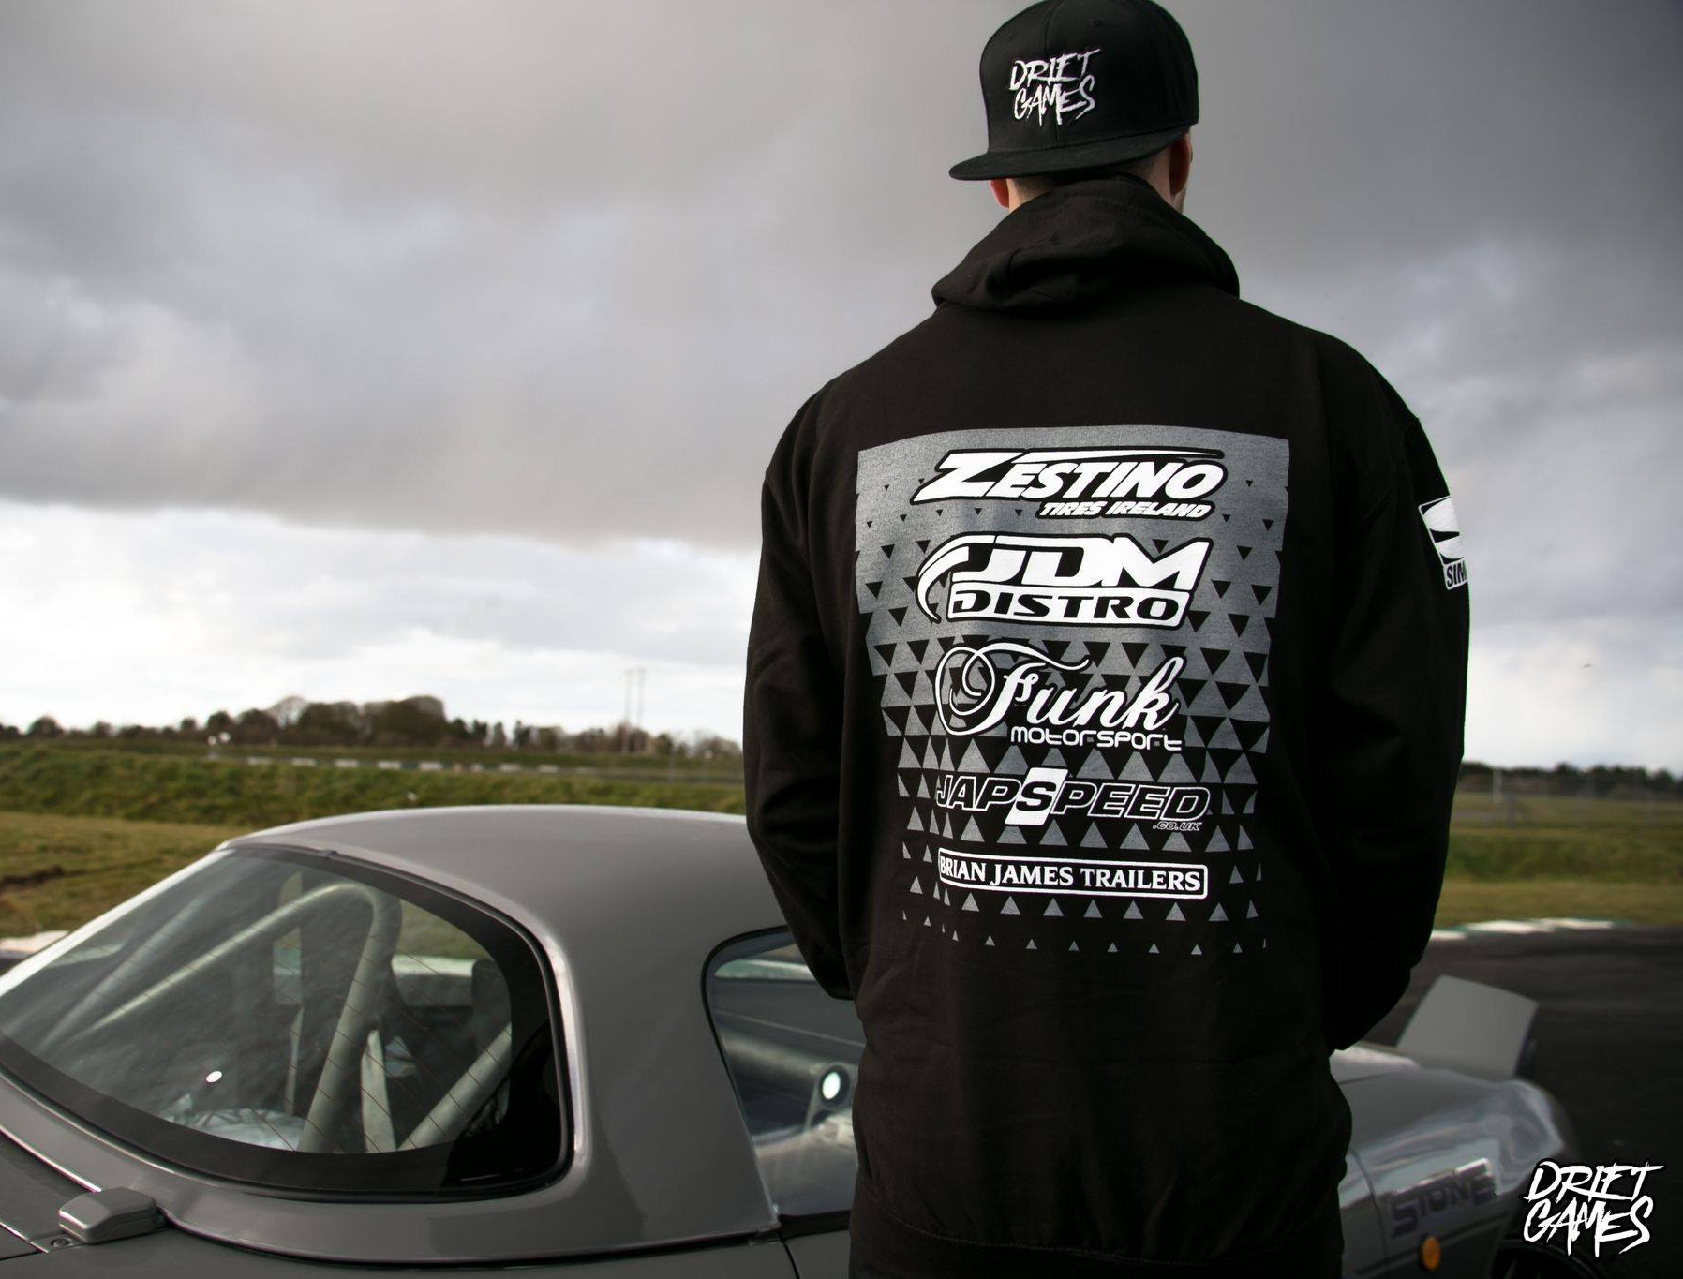
EXPECTED OUTPUT

Slide 9
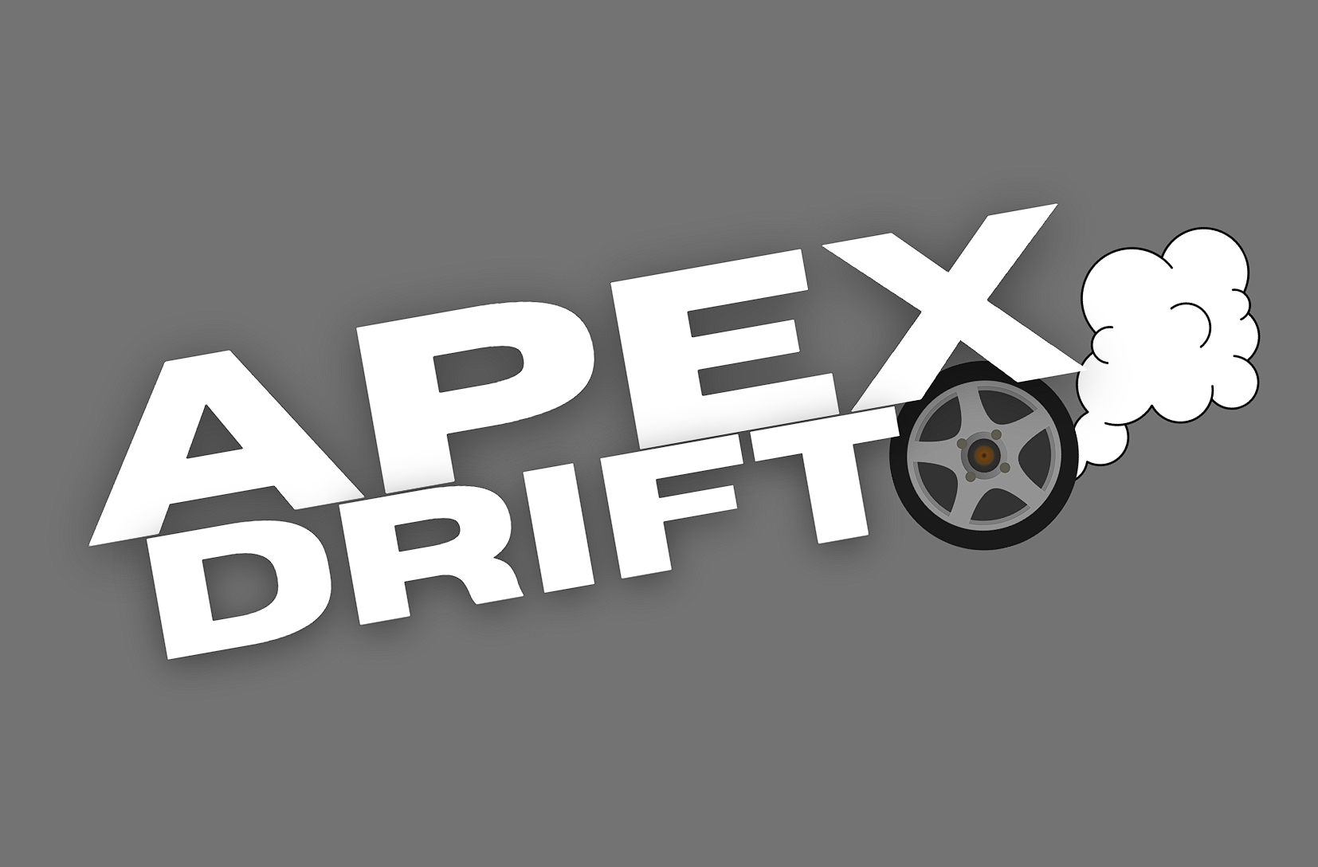
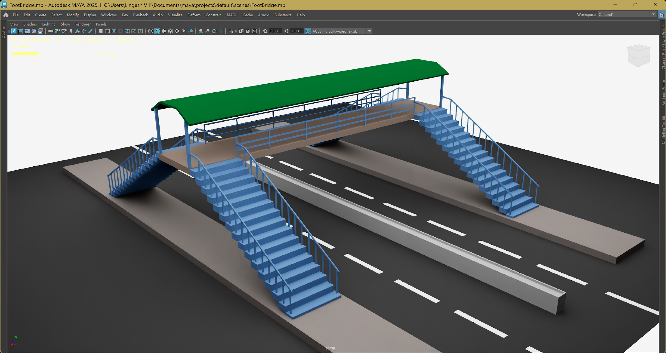
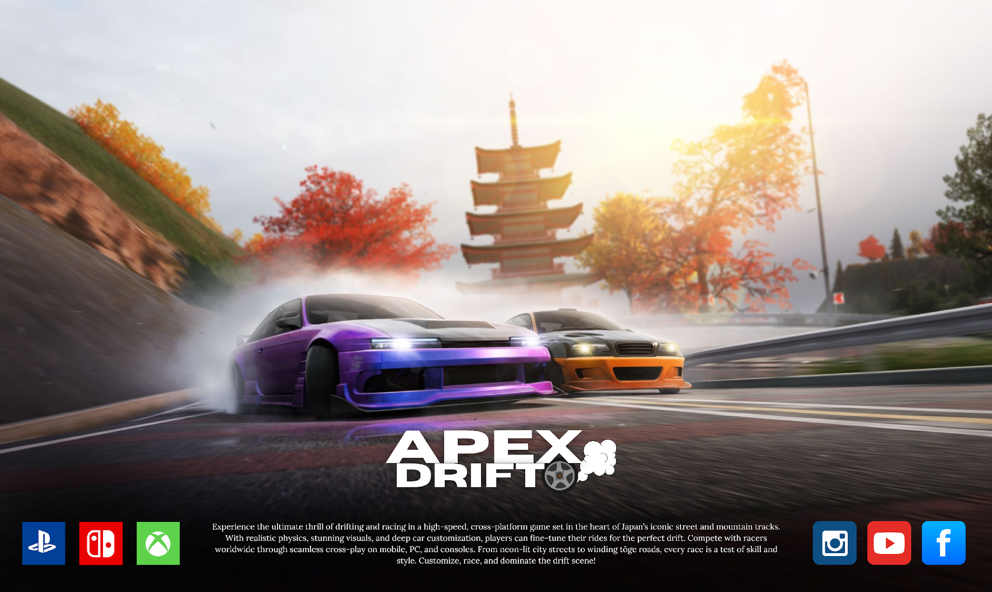
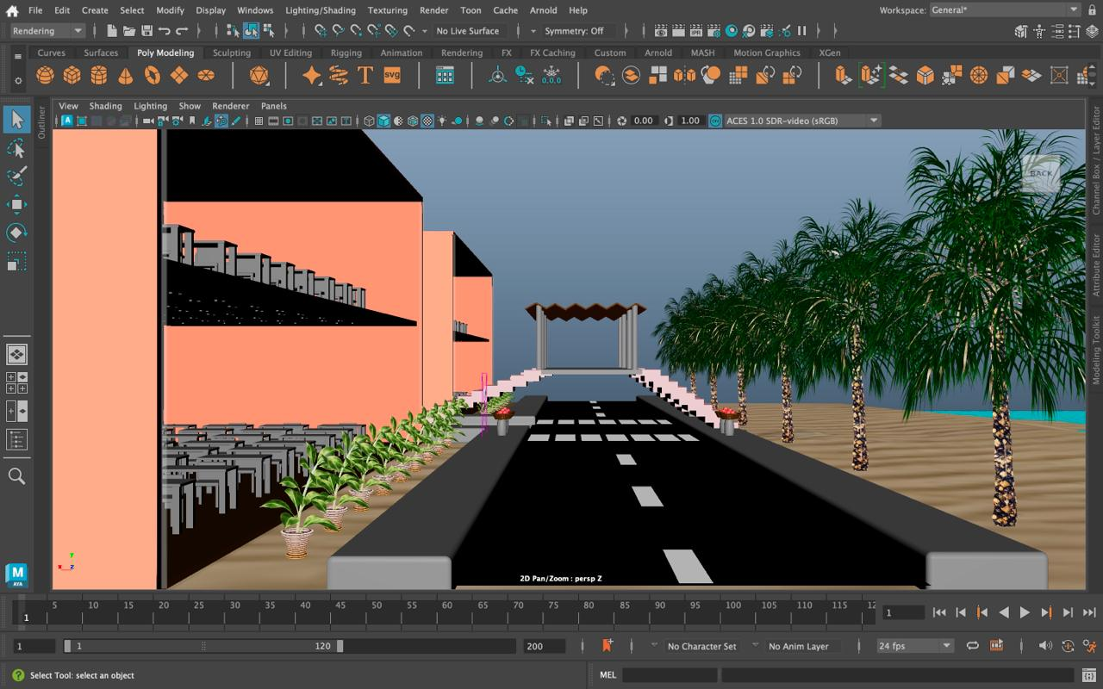
CURRENT PROGRESS

Slide 10
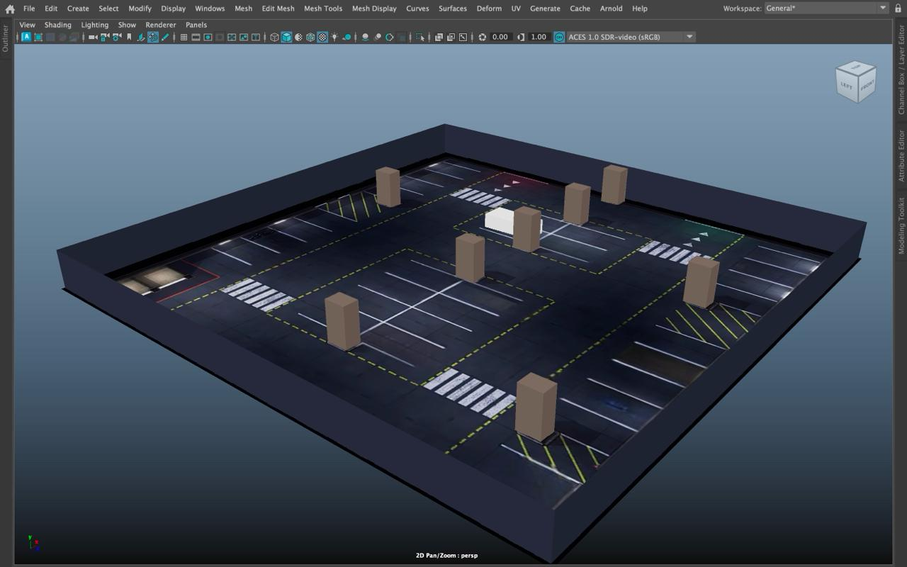
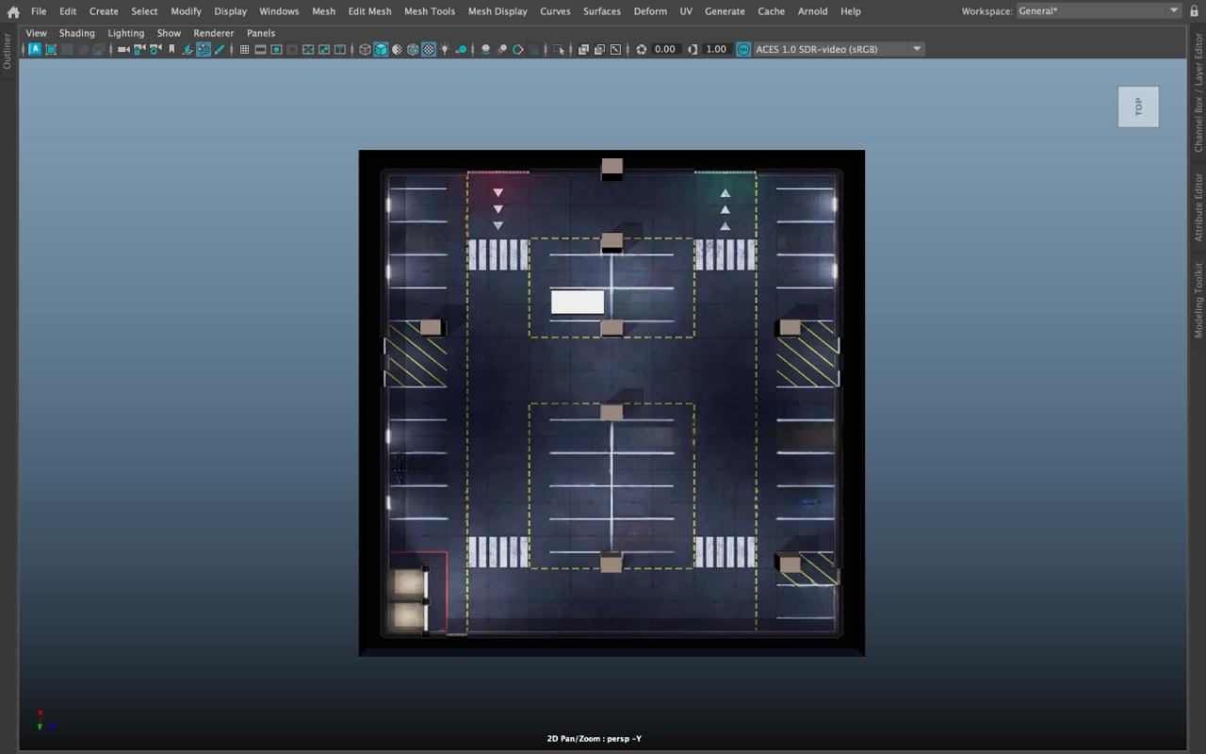
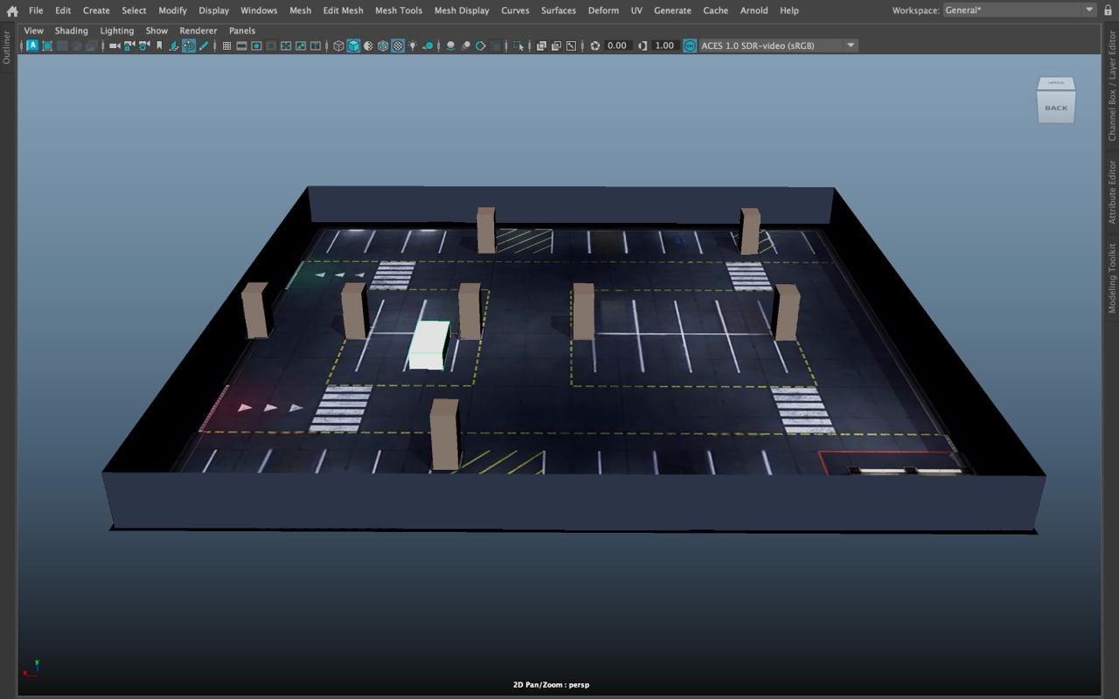
CURRENT PROGRESS

Slide 11
THANK YOU

